Slide 1
Jakarta-Indonesian Primary students’ experiences in school
Deasyanti and Ratna
PhD students
School of Education

Slide 2
Outline Presentation
Background
Research Questions
Methodology
Results
Implication

Slide 3
Background
  Indonesian education system
    Teacher center
    Content driven
    Competitive
    Rote learning
  Location of the study
    East Jakarta → urban setting
    8 Primary schools from public and private
    Ratna’s: 337 students and 31 teachers
    Deasy’s: 345 students and 17 teachers

Slide 4
Research Questions
  What factors influence academic help-seeking behaviour among primary students in Jakarta, Indonesia?
Are the students satisfied with their school experience? And what kind of positive and negative emotions do students experience frequently in school?

Slide 5
Methodology
Mixed methods
  Questionnaire,
  Focus group interviews
  Individual interview
  Classroom observations
  Student’s story and drawing
Fieldwork
  Data collection was carried out from September 2012 to January 2013.

Slide 6
RESULTS (Ratna)
  Students willingness to ask for help
    They were willing to ask for help
    Mean of students’ academic help-seeking = 3.19
    (scale 1-4)
Teachers’ views:
  Asking is difficult for students
  Teachers’ obligation to promote this behaviour
Students’ views:
  Rarely ask for help especially in the classroom
The forms of students’ academic help-seeking:
  Formal
  Informal forms

Slide 7
RESULTS (Ratna)
Factors
  External
    The salient factors from the external are
      Teachers’ behaviour and responses
      Peers
      Parents
  Internal
    Students’ characteristics → Shy vs. confident
    Learning motivation
    Age → early adolescence

Slide 8
Results (Deasy)
Are kids happy with their school experience?
  Fortunately, they are happy (M school satisfaction scale = 3.60, M positive emotions = 3.67; M negative emotion = 2.65 (Likert-type scale 1-5)
  What are the most frequent positive emotions?
    Joyful; lively; delighted; happy
Are kids unhappy with their school experience?
  What are the most frequent negative emotions?
    Tired; confused; upset; jittery
  What makes them are unhappy with their school experience?
    Teachers
    Parents

Slide 9
Results (Deasy)
Quote students about teachers
When there is a student who do not understand, the teacher calls him as “stupid”
  (KP Primary School, group1)
The teacher often mentions students’ names who got bad score in a test, and then the teacher gets angry with them. When they do not understand the lesson, the teacher gets angrier….. It seems that the teacher compares the students each other. The teacher doesn’t pay any attention on the low scorers.
  (KP Primary School, group 2).
Quote students about parents
‘I feel tired after school. Even on Sunday, I have to study, too. I have to prepare for a test”
  (KP Primary School, group 1)
“Because I am in excellent class. I feel depressed. I have to get higher score to save my face.”
  (M Primary School, group 1)
“….. we are under pressure, we do not have enough time for playing”
  (M Primary School, group 1)

Slide 10
Implication
Providing a better learning environment for:
  Students’ academic help-seeking behaviour
  Students’ well-being
Important contribution to the body of knowledge related to the study

Slide 11

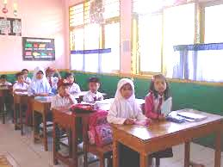
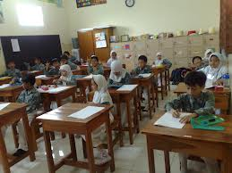
Thank You

